Slide 1
What Do Successful Recipes Have in Common?
Capstone 1 Project Report
By Anna Kantur

Slide 2












Introduction
What do successful recipes have in common?
Is it nutritional value?
Number of steps in a recipe?
Time to cook?
A specific ingredient?
Something else?

Slide 3

Who might care?
Grocery store owners who decide what products to put on display for advertisement
Professional and amateur cooks who want to create the best recipes
Meal kit services who are want to offer best recipes

Slide 4

Dataset
180K+ recipes and 700K+ recipe reviews covering 18 years of user interactions and uploads on Food.com (formerly GeniusKitchen)
Kaggle:
https://www.kaggle.com/shuyangli94/food-com-recipes-and-user-interactions

Slide 5

Data Wrangling
Remove Irrelevant Data and Missing Values
210,244 recipes, but only 18,762 with more than 10 reviews
Keep only > 10 reviews
CSV
'RAW_recipes.csv' and 'RAW_interactions.csv'
pandas
recipes_df
reviews_df
0 star ratings
present in 58% of unique recipes and represent 6% of all the reviews. Allowed on Food.com
Keep them
Recipe Tags
Wrangle the data to have each tag as a separate column and 0/1 if present/not present in the recipe
Create tags_matrix data frame
Recipe Ingredients
Remove duplicate names, e.g. cilantro and fresh cilantro
For ingredients in > 100 recipes have each ingredient as a separate column and 0/1 if present/not present in the recipe
Create ingredients_matrix data frame
Data frames for further use:
recipes_df
reviews_df
ingredients_matrix
tags_matrix

Slide 6

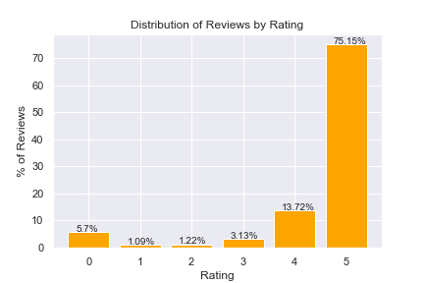
Data Summary
Average recipe rating = 4.435
75% of reviews are 5 stars
495 unique recipe tags
149 unique recipe ingredients

Slide 7
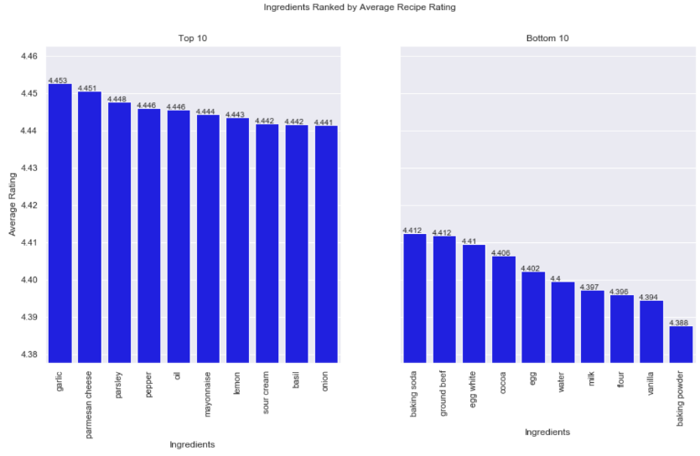
Best and Worst Ingredients
Garlic is the best ingredient (average recipe ranking of 4.453)
Baking powder is the worst ingredient (average recipe ranking of 4.388)

Slide 8
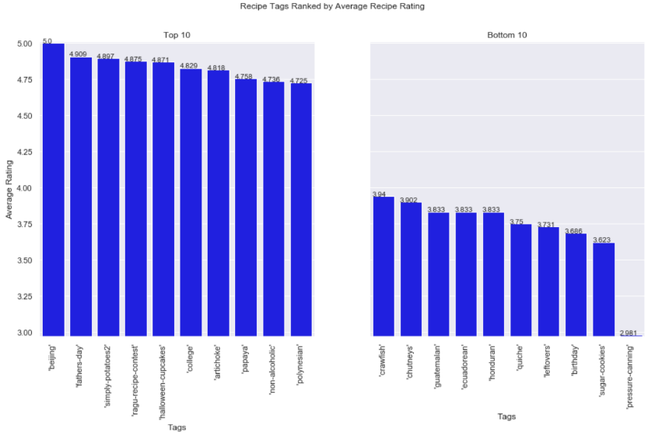
Best and Worst Tags
Beijing is the best tag (average recipe ranking of 5.000)
Pressure canning the worst tag (average recipe ranking of 2.981)

Slide 9
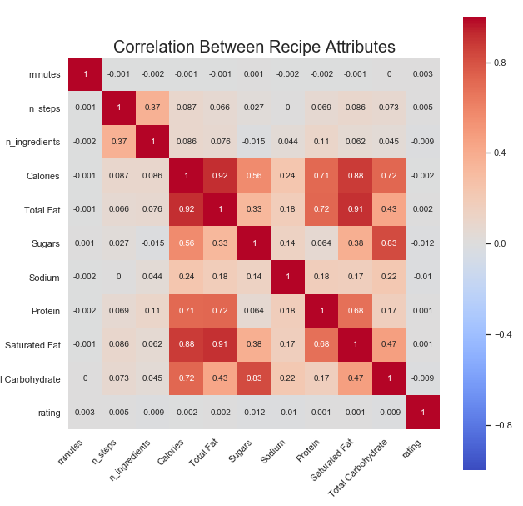
Nutritional Values Correlation Matrix
There is a strong correlation between calories content and total fats (saturated fats specifically), protein and carbohydrates.
However, there is no strong correlation between the recipe rating and any of the mentioned recipe attributes

Slide 10


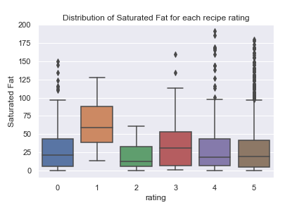

Statistical Analysis
t-test results:
Garlic
p-value = 9.475783077096418e-18
Baking Powder
p-value = 9.475783077096418e-18
‘Beijing’ recipe tag
p-value = 0.13
'pressure-canning' recipe tag
p-value = 2.792736995754129e-10
Saturated Fats Content
p-value = 0.03

Slide 11

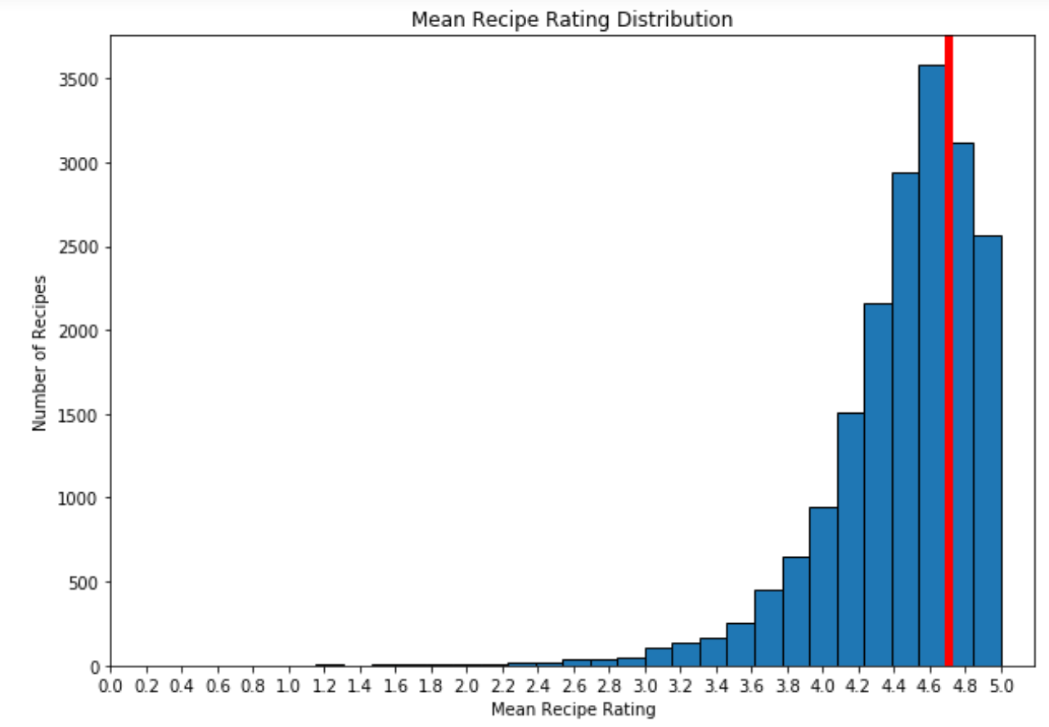
Machine Learning
Predictive Modelling
We choose 4.7 average recipe rating as a divide for “good” vs “bad” recipes
There are 5,519 “good” recipes and 13,302 “bad” recipes in our dataset.

Slide 12
Machine Learning
Predictive Modelling – Random Forest
Top 20 Features:
0 ('Calories', 0.03599724473589182)
1 ('Sugars', 0.034046714261403835)
2 ('Protein', 0.032015894747727876)
3 ('minutes', 0.031239016224030726)
4 ('Saturated Fat', 0.03111097618770412)
5 ('Sodium', 0.03047736900924014)
6 ('Total Fat', 0.030016450811690142)
7 ('Total Carbohydrate', 0.028400197936175275)
8 ('n_steps', 0.02699280475047596)
9 (" 'easy'", 0.007238298792856107)
10 (" 'equipment'", 0.006913044424659004)
11 (" 'occasion'", 0.006421651924366628)
12 (" 'number-of-servings'", 0.0061877163666479535)
13 (" 'cuisine'", 0.006035790961877401)
14 (" 'oven'", 0.005836153491809918)
15 ("'60-minutes-or-less'", 0.005774535718058847)
16 (" 'low-in-something'", 0.0056769836799905275)
17 ('salt', 0.005489661715824159)
18 (" 'taste-mood'", 0.005294530153120957)
19 (" 'inexpensive'", 0.005267690999395954)

Slide 13
Machine Learning
Predictive Modelling – Best Model
Model | Best Score | Best Parameters
Random Forest | 62% | {'max_depth': 11, 'max_features': 20, 'min_samples_leaf': 1, 'min_samples_split': 2, 'min_weight_fraction_leaf': 0, 'n_estimators': 100}
Random Forest with 20 Best Features | 57% | {'max_depth': 7, 'max_features': 5, 'min_samples_leaf': 3, 'min_samples_split': 5, 'min_weight_fraction_leaf': 0, 'n_estimators': 100}
Logistic Regression | 54% | {'C': 8.483428982440725e-05, 'class_weight': None}
KNN | 54% | {'n_neighbors': 20, 'weights': 'distance'}

Slide 14
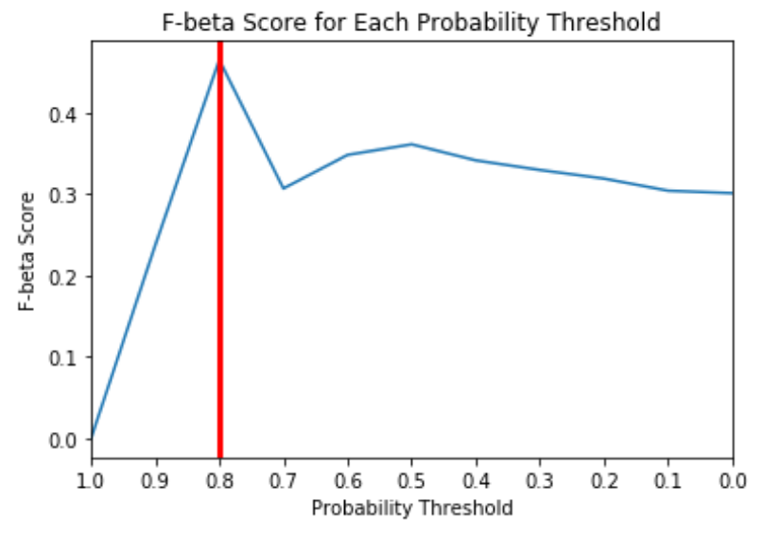
Machine Learning
Predictive Modelling – Thresholding Probability
The optimal probability threshold = 0.8, at which the F-beta score = 46%.

Slide 15

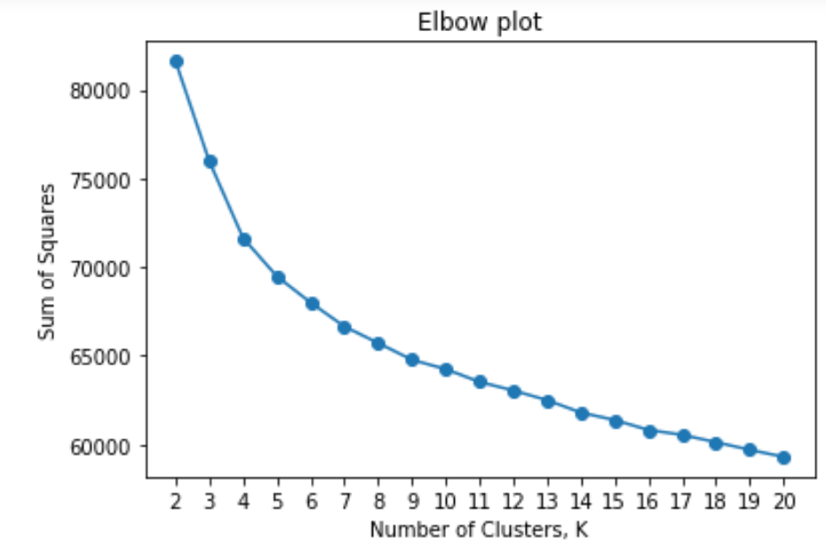
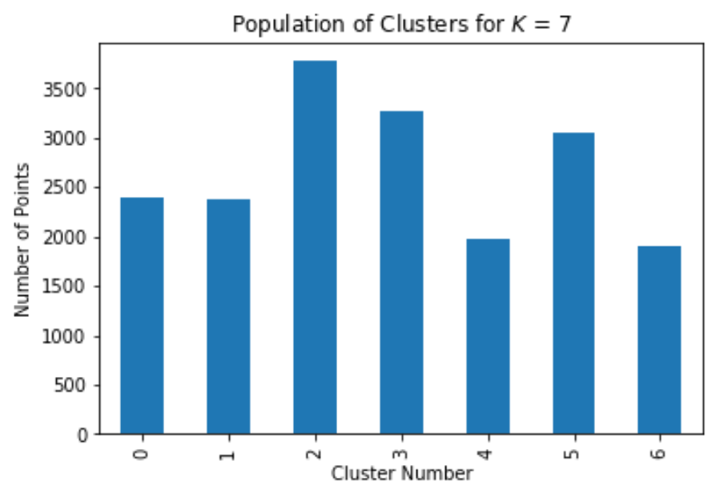
Machine Learning
Clustering – The Elbow Method
The best K is somewhere between 3 and 7.
We try K=7:

Slide 16
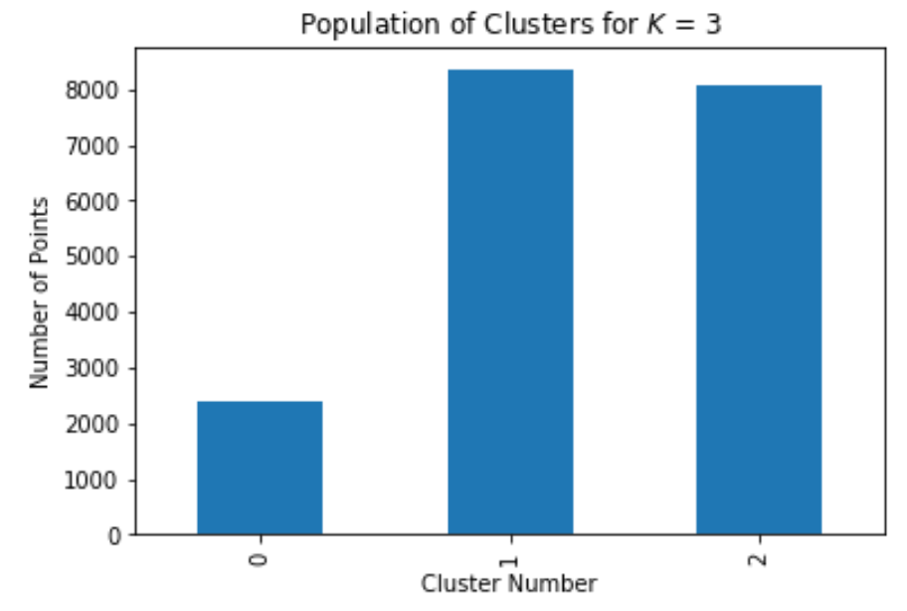
Machine Learning
Clustering – The Silhouette Method
For K between 4 and 7 we get the following results:
For n_clusters = 3 The average silhouette_score = 0.19172585856463387
For n_clusters = 4 The average silhouette_score = 0.18957449729577003
For n_clusters = 5 The average silhouette_score = 0.18111405590654364
For n_clusters = 6 The average silhouette_score = 0.16267324366196434
For n_clusters = 7 The average silhouette_score = 0.1632525460602517

Slide 17
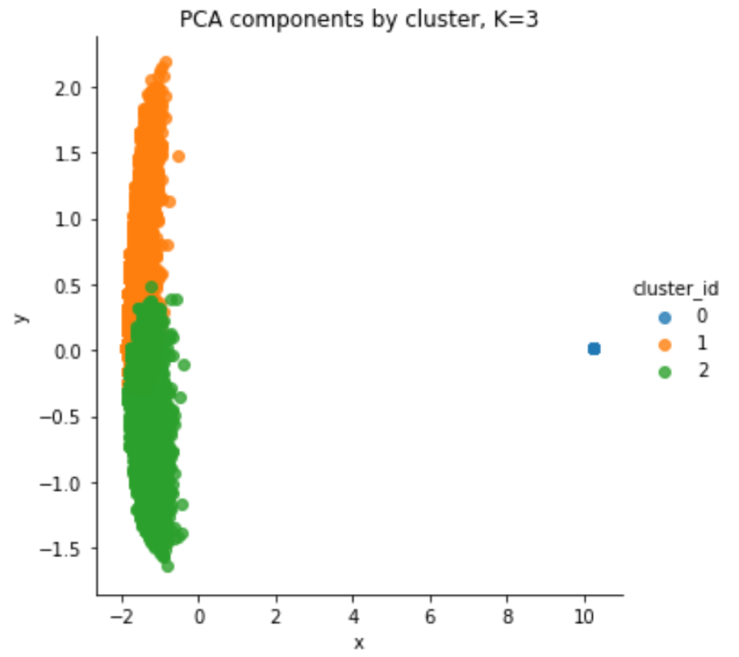
Machine Learning
Clustering – PCA Dimension Reduction
We use PCA to reduce the dimensionality of our data from 149 dimensions (e.g. ingredients) to 2 dimensions

Slide 18
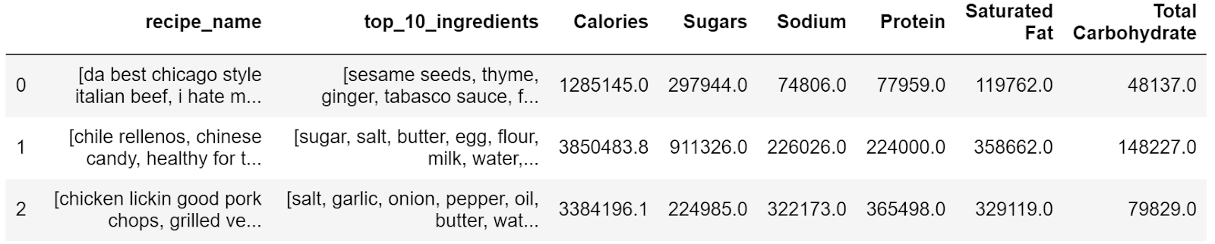
Machine Learning
Clustering – Results
Cluster 1 Desserts/Baking
Cluster 0 Mid Day Meal
Cluster 1 Dinner

Slide 19

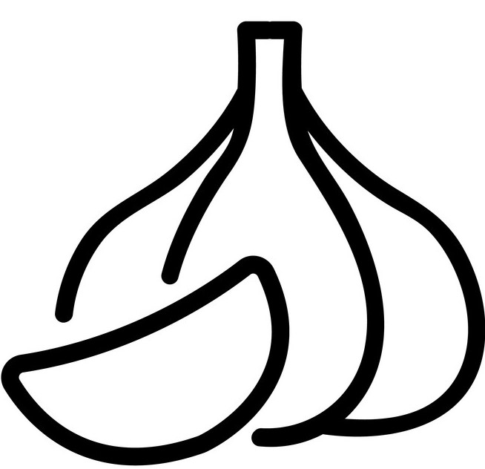



Recommendations
Use garlic in recipes, people love it
Avoid recipes requiring pressure-canning or high amounts of saturated fats
For grocery store owners it might be wise to arrange the products around the three recipe clusters that we found: Desserts/Baking Cluster, Mid Day Meal Cluster, and Dinner Cluster
To get an idea of how much people would like your recipe, think about nutritional values and how long it takes to make the recipe

Slide 20
Ideas for Further Research
No significant recipes cluster structure has been found
Even the best classification model had a very low ROC_AUC score of 62% (50% being the minimum)
Python gave a warning about F-beta score being ill-defined
Further exploration and adjusting the border for “good” and “bad” recipes by average score can uncover more meaningful insights into data
Analyzing statistically significant findings: garlic, pressure-cooking, saturated fats

Slide 21
Thank You!
Anna Kantur
https://www.linkedin.com/in/annakantur/
https://github.com/a-kantur

